Slide 1
Database Caching in-memory with Redis NoSQL Databases
Author: Artan Ajredini
Neelansh Mathur
B2 1911093

Slide 2
Goal of the paper
The goal of the paper is to explain Redis and NoSQL databases, how they perform independently, the need for them, challenges and how we can be use them together in the end to deliver a performant database and caching solution.

Slide 3
Introduction
In recent times, in-memory data processing is becoming more and more valuable as it is essential to examine a huge amount of information in a shorter amount of time. Working with large amounts of data is always the problem in development and daily maintenance. If SQL is used to store that huge amount of data, it is impossible to process unpredictable and unstructured information.
For example, a social media network demands for an occurrence-oriented database that is very flexible and operates on a schema of less data modelling.
NoSQL, the ability to support large volume of read-write operations and store generic objects, such as JSON, simply contributes to data consistency in distributed system. This shows that NoSQL database is a great choice for processing big and unstructured data.

Slide 4
What is Redis?
Redis is an in-memory data structure store that offers high performance, is flexible and open source.
Redis is used as cache but is also an advanced key-value store database. Although if you want to store more data you need to have a large of capacity of RAM.

Slide 5
Redis: Data Persistence
Persistence means that the data survives after the process with which it was created has ended. Here it means that the data you have on the RAM is stored in a file.
When using an in-memory database like Redis, one of the first questions that’s asked is “What happens when my server gets turned off?” Redis has two different forms of persistence available for writing in-memory data to disk in a compact format.

Slide 6
Redis: Industry usage
Redis have a wide usage in social media applications working on large amount of data. In present, Big data processing, in-memory enumerate have become popular due to increased capacity and high throughput of main memory.

Slide 7
Challenges to using a disk-based database
When you’re building distributed applications that require low latency and scalability, disk-based databases can pose a number of challenges. A few common ones include the following:
Data retrieval speed from disk plus the added query processing times generally put query response times in double digit millisecond speeds, at best. This assumes that you have a steady load and your database is performing optimally.
Cost to scale: Whether the data is distributed in a disk-based NoSQL database or vertically scaled up in a relational database, scaling for extremely high reads can be costly. It also can require several database read replicas to match what a single in-memory cache node can deliver in terms of requests per second.

Slide 8
Challenges to using a disk-based database
Need to simplify data access: Although relational databases provide an excellent means to data model relationships, they aren’t optimal for data access. There are instances where your applications may want to access the data in a particular structure or view to simplify data retrieval and increase application performance.
Caching: Before implementing database caching, many architects and engineers spend great effort trying to extract as much performance as they can from their databases. However, there is a limit to the performance that you can achieve with a disk-based database, and it’s counterproductive to try to solve a problem with the wrong tools. For example, a large portion of the latency of your database query is dictated by the physics of retrieving data from disk.

Slide 9
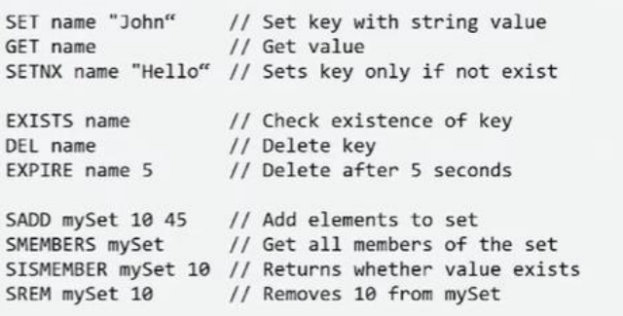
Using Redis
Redis has five major data structures: Set, Zset, List, Hash and String, which grant it a promising flexibility. Compared with SQL, even with other NoSQL, this group of data structures makes Redis stand out.
Some basic operations with redis:

Slide 10
NoSQL Databases

Slide 11
NoSQL Databases
According to NoSQL data model, the data stores are grouped into four categories:
Key-value data stores: The data are stored as key-value pairs. This data structure is also known as “hash table” where the data are retrieved by keys.
Document stores: The data are stored in collections that contain key-value pairs which nest key value pairs in JSON (Javascript Object Notation) or JSON-like documents.

Slide 12
NoSQL Databases
Column family stores: The data are stored as a set of rows and columns where columns are grouped according to the relationship of data.
Graph databases : Stores data in the form of a graph, which is made up of two things: nodes act as the entities or objects and edges act as the relationship between the entities or objects.

Slide 13
Advantages of Redis compared to Other NoSQL Databases
Unlike MongoDB, the unique data storing of Redis makes itself good at IO speed. Its data is stored in memory, therefore IO performance is guaranteed. However, memory is powerful, but expensive.
It is not realistic to store a large amount of data in memory. Redis gives us its solution of optimization, the EXPIRE key. Set a timeout on key. After the timeout has expired, the key will automatically be deleted. A key with an associated timeout is often said to be volatile in Redis terminology.
Redis is great at caching, and working on a small a amount of data. However Redis is much more than a cache.

Slide 14
What is application cache?
Once an application process uses an external data source, its performance can be bottlenecked by the throughput and latency of said data source.
When a slower external data source is used, frequently accessed data is often moved temporarily to a faster storage that is closer to the application to boost the application’s performance. This faster intermediate data storage is called the application’s cache.
It is a term originating from the French verb “cacher” which means “to hide”.

Slide 15
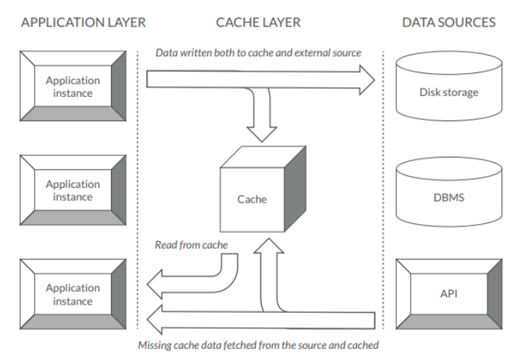
High level overview of cache
Side note: Browser cache works the same way for your frequently visited web-pages

Slide 16
Additional benefits of Cache
Without the use of a cache, the application interacts with the data source for every request. An application-side cache effectively reduces all resource demands needed to serve data from external sources, thus freeing these resources for other uses.
Additionally, a cache also contributes to the application’s availability. External data sources may experience failures that result in degraded or terminated service. During such outages the cache can still serve data to the application and thus retain its availability.

Slide 17
Typical uses of a cache in an Application
Configuration settings
Localization and internationalization data
Templates and partially rendered responses
Reusable results of compute-intensive functions
Session data
DBMS data
API responses

Slide 18
Strategy to Implementation

Slide 19
Implementation
In this paper, they mainly consider the method which improves the system performance by caching data in an API.
Implementation of this method is with NodeJS code in the backend. We will interface with the redis-client and redis-server packages to work with Redis, and any NoSQL database to store the primary data.
Idea: If we work with all-time best-selling books it is a good idea that the items we get from the database can be cached in Redis in order to have faster access.

Slide 20
Technology to be used
Backend: NodeJS, Express
Databases: Redis (Local / Heroku), Firebase Firestore (NoSQL)
Frontend: HTML, CSS, Javascript, VueJS
Sein-redis (npm)

Slide 21

Code snapshots from the paper

Slide 22
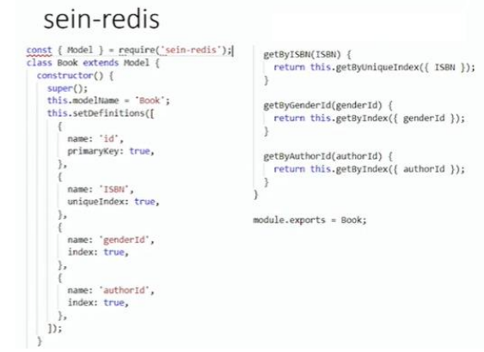
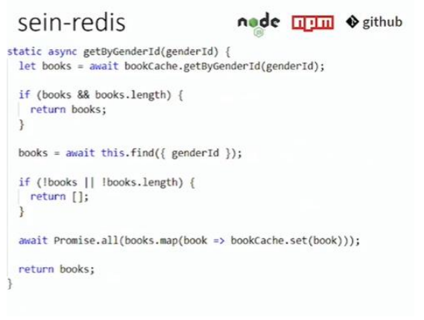

Slide 23
Expected results
Implementation of Redis with NodeJS
Benchmark response times with and without Redis
Response times in a scenario where there is randomization of data.

Slide 24
References
[1] Cattell, R., 2011. Scalable SQL and NoSQL data stores. Acm Sigmod Record, 39(4), pp. 12-27. .
[2] DeZyre ”NoSQL vs SQL- 4 Reasons Why NoSQL is better for Big Data applications” https://www.dezyre.com/article/nosql-vs-sql-4- reasonswhy-nosql-is-better-for-big-data-applications/86 19 Mar 2015
[3] Zachary Parker,Scott Poe,Susan V. Vrbsky ”Comparing NoSQL MongoDB to an SQL DB ” C3S2E ’13 Proceedings of the International C* Conference on Computer Science and Software Engineering Pages 14- 22 Porto, Portugal July 10 - 12, 2013
[4] A. Oussous, F. Z. Benjelloun, A. A. Lahcen, S. Belfkih, “Comparison and Classification of NoSQL Databases for Big Data”
[5] Aaron Schram, and Kenneth M. Anderson. ”MySQL to NoSQL: data modeling challenges in supporting calability.” In Proceedings of the 3rd annual conference on Systems, programming, and applications: software for humanity, pp. 191-202. ACM, 2012.
[6] R. Elmasri and S. Navathe, Fundamentals of Database Systems. 7th ed., Chap. 23-24, Pearson Education, 2015.
[7] Josiah L. Carlson, Salvator Sanfilippo “Redis in Action”
[8] Stonebreaker, M. 2010. SQL Databases v. NoSQL Databases. Communications of the ACM, Vol. 25, No. 4, pp. 10-11.
[9] Itamar Haber – Redis as in-memory applications cashe

